Slide 1



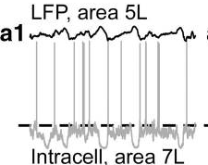
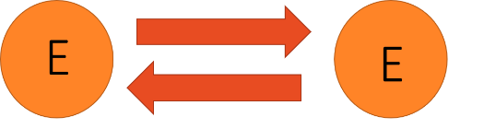
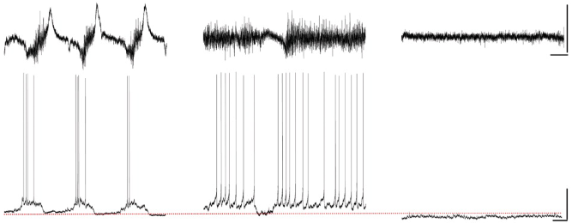
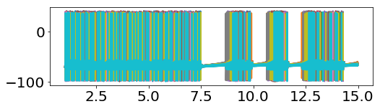
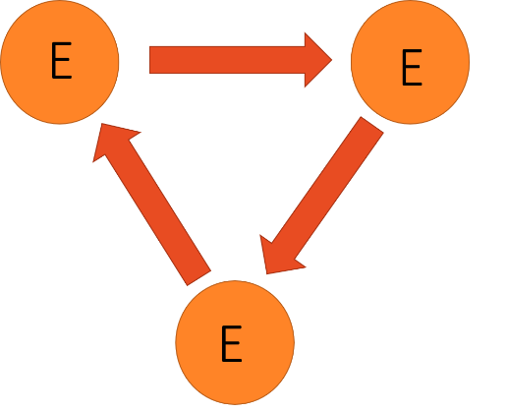
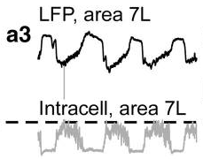
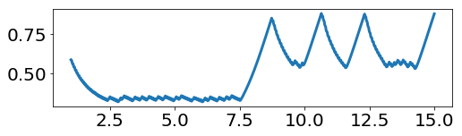
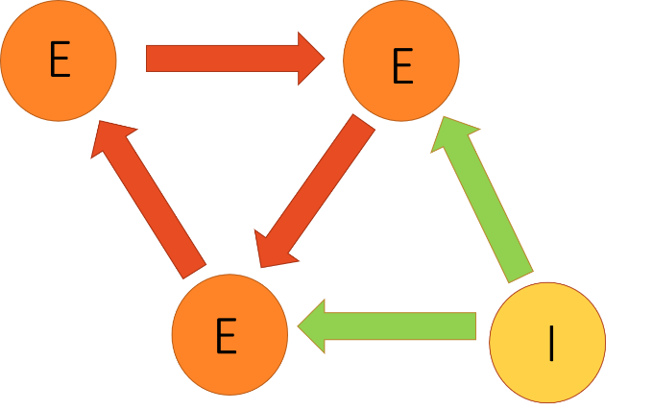



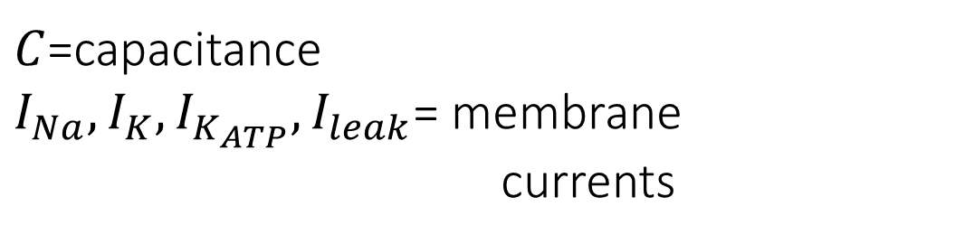
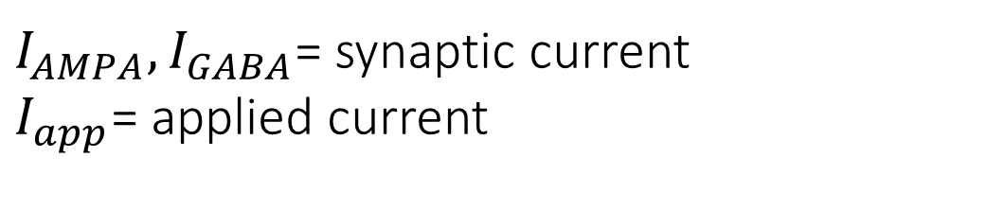
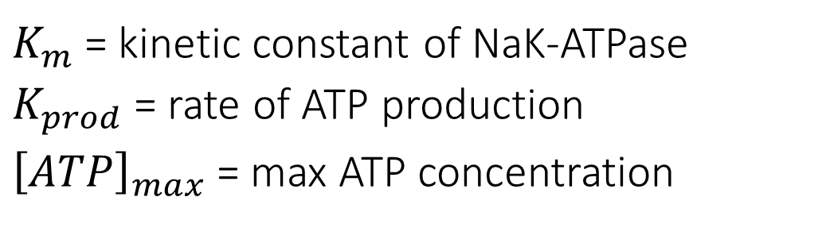

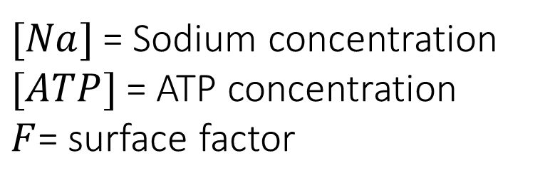

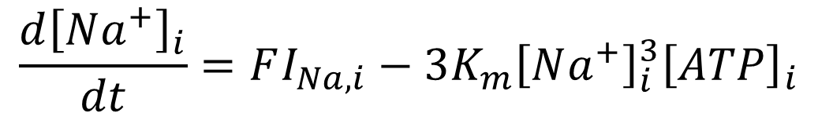
Computational modeling of cortical transition to slow wave oscillations modulated by K-ATP current
Beverly Setzer¹, Marek Kowlaski^{2,1}, Ph.D., Emery Brown⁴, M.D., PhD, Michelle McCarthy³, M.D., Ph.D., Nancy Kopell^{1,3}, Ph.D.
Boston University Graduate Program in Neuroscience₁, Boston University Medical School₂, Boston University Department of Mathematics₃, Massachusetts Institute of Technology₄
Introduction: The occurrence of slow wave oscillations is modulated by neuron metabolism.
METHOD: Hodgkin-Huxley based modeling
Slow wave oscillations (SWO) occur in unconscious states
What mechanisms underlie the generation of slow wave oscillations observed under anesthesia?
Neurons:
Networks:
Activity dependant ATP-modulated potassium (K _{ATP} ) current has been implicated in SWO generation
Networks oscillate at high and low excitation states
The change in neuron voltage ($V_{m}$) over time is modeled by:
Propofol
Ketamine
$$C\frac{dV_{m}}{dt}=−I_{Na}−I_{K}−I_{K_{ATP}}−I_{leak}−I_{AMPA}−I_{GABA}+I_{app}$$
During states of unconsciousness, networks of neurons in the brain demonstrate periods of high-frequency activity interspersed with periods of quiescence which gives rise to slow wave oscillations (SWO).
I_{APP} decreased
Network disinhibited
$C$=capacitance
$I_{Na}, I_{K},I_{K_{ATP}},I_{leak}$= membrane
currents
$I_{AMPA}, I_{GABA}$= synaptic current
$I_{app}$= applied current
Deep sleep
In-vitro studies demonstrate that slow wave oscillations may be a consequence of interactions between neuronal network-mediated mechanisms and neuronal metabolism-related mechanisms. (2)
Control
voltage (mV)
K_{ATP} current:
[ATP]
We add the additional K_{ATP} current [3]:
K_{ATP} Channel blockade
[ATP]
$$\frac{d{\left[Na^{+}\right]}_{i}}{dt}=FI_{Na, i}−3K_{m}{\left[Na^{+}\right]}_{i}^{3}{\left[ATP\right]}_{i}$$
Time (mS)
$$\frac{d{\left[ATP\right]}_{i}}{dt}=K_{prod}({\left[ATP\right]}_{max}−{\left[ATP\right]}_{i})−K_{m}{\left[Na^{+}\right]}_{i}^{3}{\left[ATP\right]}_{i}$$
Ketaimne-xylazine
SWO occur at both high and low I_{APP}, but not at mid-ranges.
${K_{m}}_{ }$= kinetic constant of NaK-ATPase
${K_{prod}}_{ }$= rate of ATP production
${{\left[ATP\right]}_{max}}_{ }$= max ATP concentration
K_{ATP} Channel activation
How are up- and down-states initiated when the K-ATP current is present?
${[Na]}_{ }$= Sodium concentration
${[ATP]}_{ }$= ATP concentration
$F_{ }$= surface factor
Chauvette et. al
Cunningham et. al
RESULTS
Synaptic connections allow ATP-mediated oscillations
Three excitatory cells: SWO occur only at high I_{APP}
High I_{APP} stops cell due to shifts in phases of action potentials
With inhibition, SWO appear only at low I_{APP}
Anesthesia-mediated SWO can be explained by 3-cell model
Single Cell: no ATP-mediated oscillations
Beginning of up-state
End of up-state
Two E Cells
Disinhibition of I-cell
Three E Cells
Cell cannot respond to synaptic input during refractory period
When one cell stops, all cells stop
Phase-shift also occurs with 2-cells
Open question: What causes phase shift only at high I_{APP} for three cells but at all I_{APP} for 2 cells?
[ATP] of each cell
boundary
Below curve → Quiescence
Above curve → Spontaneous spiking
[ATP]
boundary
I_{APP} increased every 20 seconds
Single Cell
[ATP]
boundary
Synaptic activity continues even when neurons are below boundary, due to excitatory input from network
Oscillations occur across full range of I_{APP} (0-11 $μ$A/cm²)
Stop one cell -> down state begins
With inhibition, there are always down-states
As I_{APP} increases, the frequency of oscillations increase
This occurs over a range of $τ_{GABA}$
High $τ_{GABA}$ applicable to propofol
Propofol SWO may be due to loss of cortical excitation (lowered I_{APP}).
Ketamine SWO may come about from disinhibition
I_{APP} increased every 20 seconds
ATP below the boundary is necessary but not sufficient for SWO
Cell 3 inhibited
Cell 3 inhibited
[ATP]
boundary
CONCLUSION: Hypothesized SWO transition
Future directions
Acknowledgements
citations
During up-state, cells spike, and ATP levels decay
(ATP level is activity dependent)
2. Individual neurons require excitation from interacting E-cells to spike when ATP levels cross the boundary
3. Changes in phase relationships during the up-state, causes some cells to stop responding to synaptic excitation, and hence stop spiking.
4. Down state caused if a sufficient number of E-cells drop out, reducing synaptic excitation such that all activity stops
5. Up-state resumes when ATP level has recovered adequately and some neurons can spike independently, activating the others
What is the origin of the phase shift?
Why can the two cell network oscillate at all levels of I_{APP}?
What determines the timescale of an upstate?
How does the anatomy of large networks affect phase shifts?
Is there any mechanism other than shift of phases to produce down state?
We thank Dr. Austin Soplata for helpful comments.
Supported by Boston University’s Graduate Program in Neuroscience and Dr. Laura Lewis.
Chauvette, S., Crochet, S., Volgushev, M., & Timofeev, I. (2011). Properties of slow oscillation during slow-wave sleep and anesthesia in cats. The Journal of neuroscience : the official journal of the Society for Neuroscience, 31(42), 14998–15008. doi:10.1523/JNEUROSCI.2339-11.2011
Ching S., Purdon, P.L., Vijayan S., Kopell, N.J., Brown, E.N. (2012). A neurophysiological-metabolic model for burst suppression. PNAS, (108)8, 3095-3100. doi:10.1073.
Cunningham, M.O., Pervouchine, D.D., Racca, C., Kopell, N.J., Davies, C.H., Jones R.S.G., Traub, R.D., Whittington, M.A. Nueronal metabolism governs cortical response state. (2006). PNAS, 103(14), 5597-5601
Notes:
Box 4: In large scale networks the structure of the connectivity will matter.
Phase shift coming from cells approaching synchrony. When it gets close enough to synchrony, the AMPA inputs come in during the refractory period. This depends on the network topology.

